Slide 1
Yesterday
Review on Google Classroom
2 Motives to Buying
3 Types of Decisions

Slide 2

It is believed customers do not buy products; rather, they buy what the products do for them
Is that true?
If so, good sales people know:
  Product features
  Benefits to the customer

Slide 3
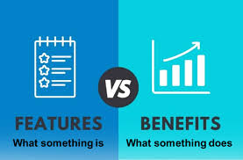
Feature-Benefit selling
Selling technique that converts a product's specific features to the tangible value or benefit they provide to the customer (benefits).

Slide 4
Quantum Light-Emitting Diode
Feature: Quantum Light-Emitting Diode
What does that mean to you?
In non-geek-speak, QLED
What is it?
Why should I buy it over the 4K?
  Super-charged brightness and color

Slide 5
Features X A feature is a physical characteristic or quality of a product that makes a customer want it (What it is)
Benefits X advantages or personal satisfaction A CUSTOMER gets from a good or service (What it does)
Selling Points: when you “use the benefit or convert the feature to how it benefits the covert

Slide 6
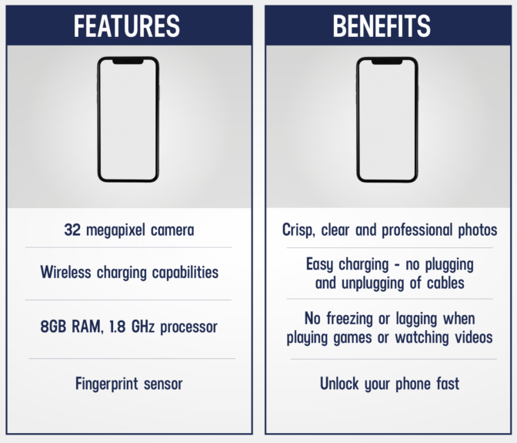

Slide 7

Kahoot 2026 Feature Benefit Selling

Slide 8

Feature-Benefit Chart
Identifying each feature of a product and convert to a customer benefit and view in chart format:
Product: Cell Phone: Use Chat GPT to assist you
Lets do this together: What is the benefit?
Feature | Selling Point (Benefit to customer)
48 Megapixel Camera
A19 Pro Chip
12 gb ram
120Hz ProMotion
8K Video

Slide 9
Feature-Benefit Chart
Product: Cough Medicine: What is the benefit?
Feature | Selling Point (Benefit to customer)
48 Megapixel Camera | Take clear, detailed photos and crop or zoom without losing quality
A19 Pro Chip | Faster performance, smoother apps, and longer battery life
12 gb ram | Run multiple apps at once without lag or slowdowns
120Hz ProMotion | Smoother scrolling on apps and social media, better gaming experience without draining the battery
8K Video | Record extremely high-quality videos that stay sharp even when edited or zoomed

Slide 10

Product features X may be basic, physical, or extended attributes of the product that make you want to purchase:
  Basic: The product’s intended use
    A car is used to drive, a watch to tell time
  Physical features: Appearance, durability – differentiates competing brands
    Engine size, gas consumption, appearance, stereo system
  Extended: additional features added to increase value (reason for price differences)
    Warranties, service policies, special features, reputation/brand of the company

Slide 11

RECAP
Go to Kahootit
Enter the Game Pin
Enter your Nick Name
Winner gets a sucker!

Slide 12
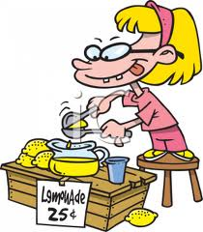

Marketing and the Marketing Concept
Study Organizer
Create a chart like this one to record important information about selling situations and customers’ decision making.
Personal Selling

